Slide 1
TU856/2 and TU858/2 Operating Systems 2 CMPU2017
Denis Manley CQ-214 denis.manley@tudublin.ie
1
Notes:
1

Slide 2
Module Aims
Introduction to fundamental programming principles related to Operating Systems management
Analysis of the major elements Operating System management
Implementing core Linux Operating System management principles
2
Notes:
2

Slide 3
Operating System management Syllabus
Operating system principles
Process Management
process and threads
principles of synchronisation
process: creation and synchronisation
threads creation and synchronisation
Principles of deadlock and starvation
Main memory management: Virtual memory

Slide 4
Operating System Programming syllabus
Implementing operating systems concepts in C
Review of basic C programming concepts
Review of pointers, pass by reference…
Use defined data Structures; records
Dynamic data structures: Link lists, Stacks and Queues
Process Creation and synchronisation using C in Linux
Thread creation and synchronisation using C in Linux

Slide 5
Labs: Linux environment
The Linux Operating System command line mode.
Students will access the Linux command line environment in a number of ways referred to below.
Linux OS server (use ssh/Putty client to access the server) This is the method that will be used in the computer labs and for lab tests – ).
Each lab will consist of a number of programming exercises the students will be expected to complete.
The first few are a revision of core c programming covered in year 1
The other labs will require the student to modify the sample code covered in the lecturers.
There will also be exercise to explain the relevant concepts being covered in the sample code exercises.
These exercises will form the basics of the two lab tests.

Slide 6
Reference Material
Understanding Operating Systems (8th Ed)
I.M. Flynn and A. Mclver-McHoes, Thompson Learning (2008)
C how to program Dietel and Dietel
Link: POSIX thread programming in C
6
Notes:
6

Slide 7
Modeule Details
3 Lectures:
1 Lab
Continuous Assessment and Examination:
40% - Continuous Assessment consist of 2 lab tests and two related in class tests.
60% - End-of Semester Examination

Slide 8
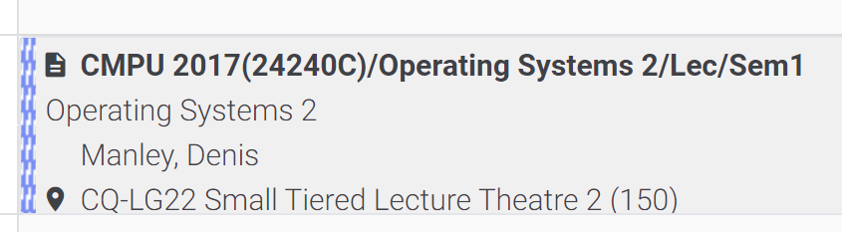
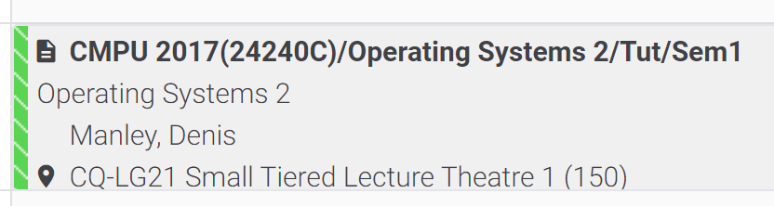
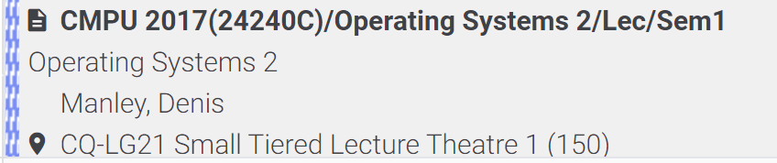
Time Table

Slide 9
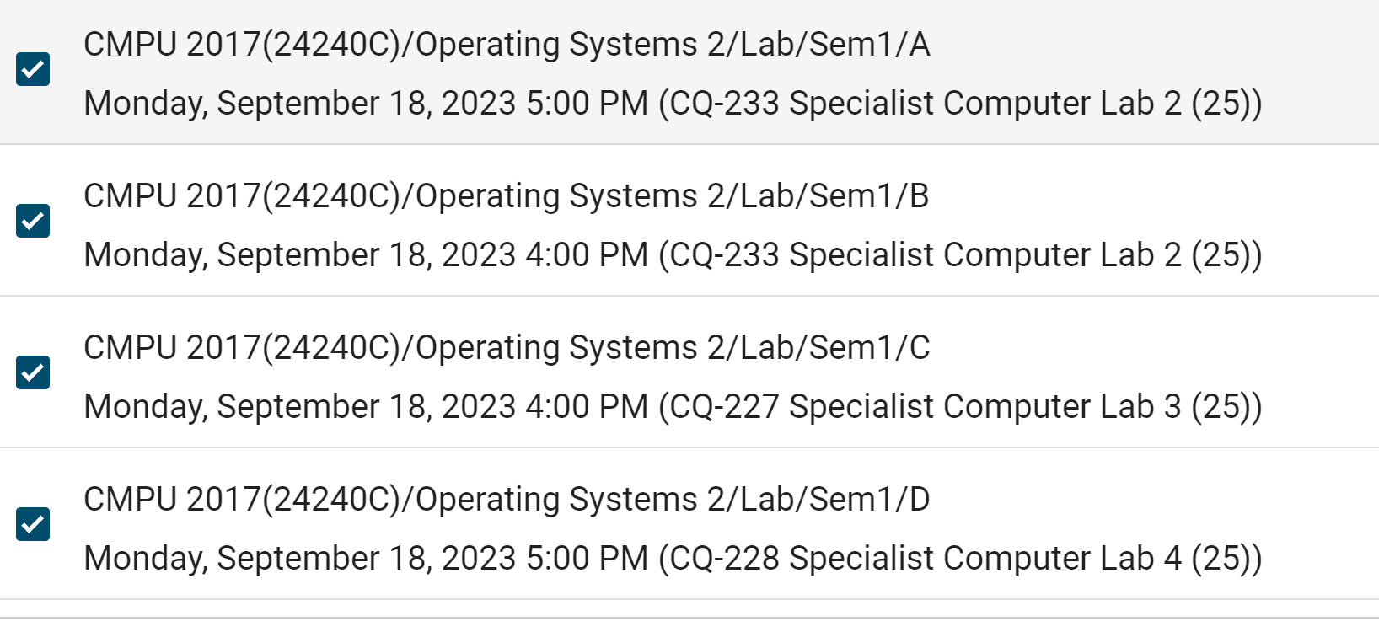
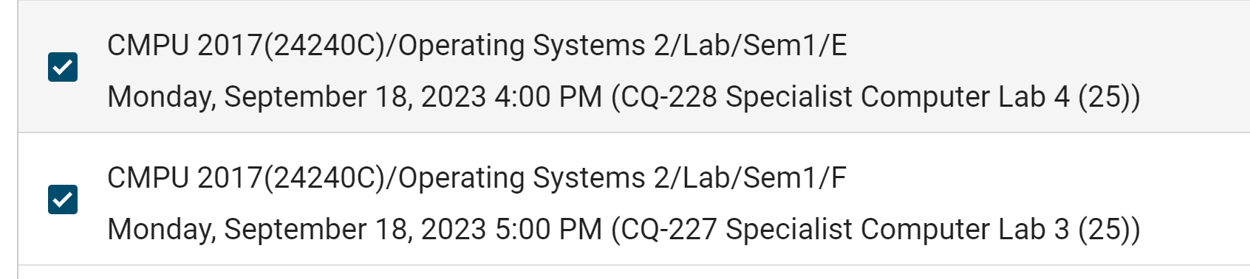
Time Table

Slide 10
Week 1 lab
Access to a linux terminal
Putty (ssh app):
The linux server IP address is: 147.252.250.34
Enter students number and password that you use to log onto the Desktops.
Create a file called HelloWorld.c using a text editor. (in the lab use the vi/nano editor refer to instructions given in the lab section of bright space).
The instructions are shown in the week 1 lab section….

Slide 11
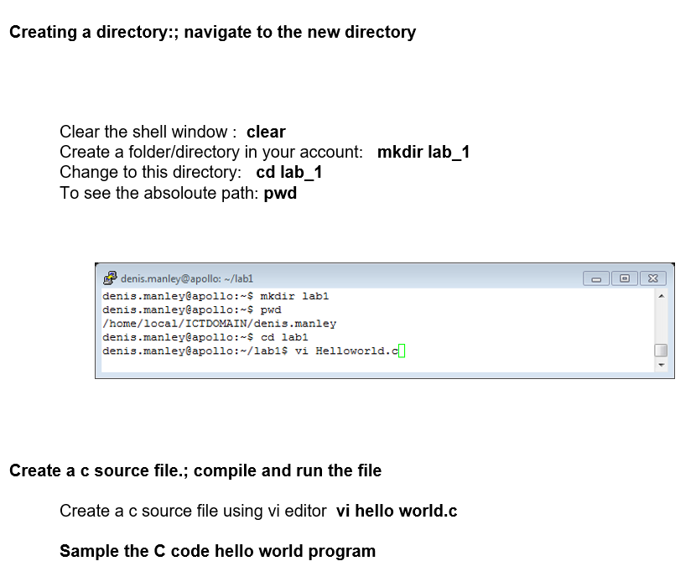
Lab 1: instructions

Slide 12
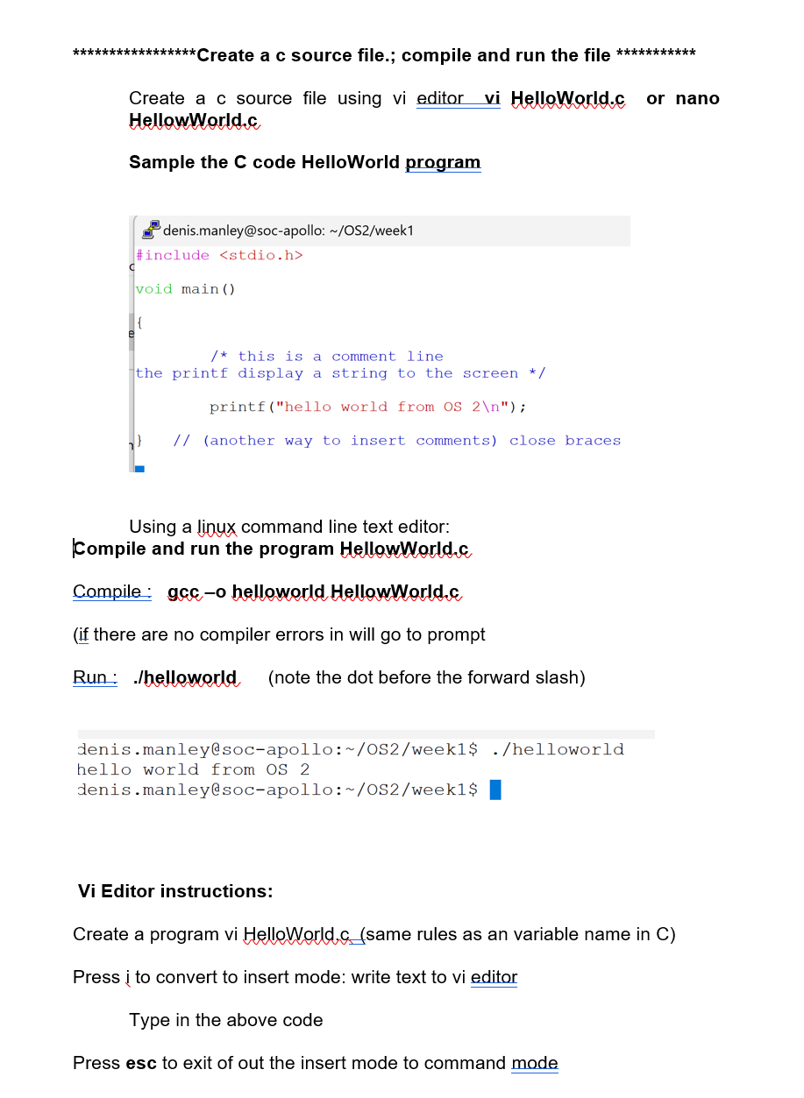
Lab 1 expected output

